Slide 1

Patient-safety challenges posed by new and emerging health information technologies
Ciarán McInerney, PhD.
@CMc_PhD

Slide 2

Introductions
Right information,
Right person,
Right place,
Right time
(Kaelber & Bates, 2007)
Kaelber and Bates, 2007. J Bio Infor. 40(Suppl 6)
Notes:
No need to go on too long about the potential benefits of innovation in health information technology. Gibbings & Wickramasinghe (2020) do a great job of summarising the literature on how information technology facilitates care coordination in healthcare. By this, we don’t just mean appropriate connection of agents in the healthcare system, we also mean connection of information, as and when appropriate: right information, right person, right place, right time (Kaelber & Bates, 2007).

Slide 3



Situational Assessment What (we think) we know
Healthcare is increasingly digital.
Healthcare Information System.
Hardware
Information is…
…created
People
Data
…transferred
Processes
…stored
Software
Icons from flaticon
Notes:
Healthcare is becoming more and more digital. Events like the COVID-19 pandemic are not only showing the usefulness of digital healthcare but might also be dealing a hard blow to non-digital healthcare.
Another thing we think we know is that, at least for the purposes of this workshop, we recognise that healthcare information technology relates to an information system, where by “system” we mean a collection of hardware, software, people, data, and processes, and their relationships to one another. When we say “information system” we mean a system in which information is created, transferred and stored. As we progress through today, please keep this in mind.

Slide 4
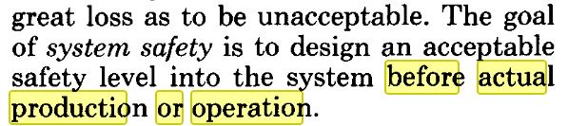

Situational Assessment What (we think) we know
Safety isn’t new…but we still haven’t cracked it.
Complex Adaptive System
vs
Tactical Exaptive System
(Gould and Vrba, 1982)
(Leveson, 1986)
Leveson, 1986. Computing Surverys. 18(2)
Gould and Vrba, 1982. Paleobiology. 8(1)
Notes:
We also know that safety isn’t a new agenda. As far back as 1994, Fox and Jackson-Smale discussed the quality and safety culture for knowledge based systems in healthcare, highlighting the unique contribution of artificial intelligence and that the technical performance of a medical technology is insufficient to instil trust nor ensure safety. Within their opening paragraph, Fox and Jackson-Smale identify that “one of the great weaknesses of [knowledge based] systems has been the relatively ad hoc nature of their development”. Although Fox and Jackson-Smale’s focus is on culture and trust, ad hoc development is also problematic for the safe implementation and use of decision support tools and systems. While progress has been made in the creation of methodologies for software development, like Discipline Agile Delivery (Ambler, 2013), the focus has been on the technical performance given initial requirements specifications, which do not always include safety. This is despite calls from as far back at the 1980s for an acceptable safety level to be designed into the software systems “before actual production or operation” (Leveson, 1986).
Finally, I hope that we all recognise that we don’t live in a world of ideals. The consequence of that realisation is that we should know that healthcare is not simply a complex adaptive system; rather, it is worse. It is a tactical exaptive system (Wyatt, 2016) because the agents at play within it are cognisant of the system and their capacities within it. That’s much worse. That’s the difference between herding sheep and herding sheep with opinions.

Slide 5
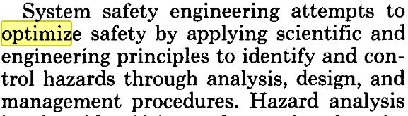
Situational Assessment What we don’t know/agree on
What is safety, in general?
Enforced state vs Elusive trait
What is systems safety, in general?
A property of a system that is maximised when all implicit and explicit expectations are met.
(Leveson, 1986)
Reliability physics
Far-from-equilibrium physics
(Pecht and Dasgupta, 1995)
(Jaeger and Liu, 2010)
Leveson, 1986. Computing Surverys. 18(2) | Pecht and Dasgupta, 1995. IEEE.
Jaeger and Liu, 2010. arXiv: 1009.4874
Notes:
Above are list of questions for which we don’t have consensual answers.
1. What is safety, in general?
We will look at this topic in greater depth in a future workshop that addresses the implications of contemporary safety theory. Generally, I consider there to be a conceptual distinction between some people who conceive safety as an ‘enforced state’, and those who conceive safety as an ‘elusive trait’. I’m borrowing the state-vs-trait distinction from psychology to distinguish between transient and latent behaviours of a system.
2. What is systems safety, in general?
There are notions of passive safety systems in the nuclear energy industry (Zio & Pedroni, 2009) that contrasts with others’ who might consider themselves external to the system while influencing the function of it. This is like the ‘enforced state’ idea I mentioned previously. This seems incompatible with a systems perspective because once you are interacting with system, surely you’re in it.
I take the position that ‘system safety’ is a property of a system that is maximised when all implicit and explicit expectations are met. Such a definition permits some expected harm in recognition of a complex adaptive system’s eternal balancing act. This perspective is informed by reliability physics (Pecht & Dasgupta, 1996) and recognises far-from-equilibrium physics that occurs when systems are not isolated (Jaeger & Liu, 2010).

Slide 6
Situational Assessment What we don’t know/agree on
What is a safe healthcare system?...
…and would you know it if you saw one?
What is a safe healthcare information system?
What is patient safety and how does it relate a healthcare information system?
What are the next innovations?...
…and what will the consequences/effects be?
Notes:
Another question for which we don’t know the answer is What is a safe healthcare system?
Can we define one, a priori? If so, that would make it analogous to the P problem class, in computer science.
Can we recognise one? If so, that would make it analogous to the NP problem class, in computer science.
Knowing to which problem class identifying a safe healthcare system belongs will guide what useful actions we could take.
By extension, I suggest we don’t really know what a safe healthcare information system looks like [What is a safe healthcare information system?]…
What “patient safety” really is and how it relates to a healthcare information system [What is patient safety and how does it relate a healthcare information system?]…
What the next innovations will be [What are the next innovations in healthcare information systems?]…
And their consequences [What are the consequences/effects of such innovations on patient safety?]
But not knowing these answers or not having consensus on these answers doesn’t mean we can’t make progress. Indeed, having multiple perspective can be very useful to tackling complex problems. Our variety of perspectives have been informed by the variety of healthcare technologies that we have each experienced and studied, and the challenges that come with them. Our focus today is on new and emerging technologies and the challenges that they might bring forth.

Slide 7
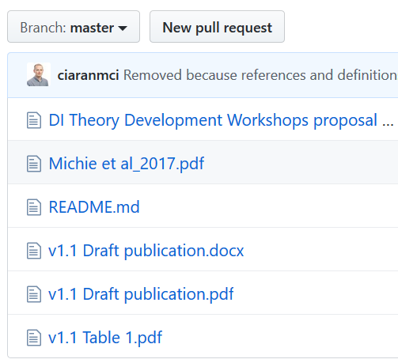
What do we mean by “new and emerging”?
New technology
New users (primary, secondary and stakeholders)
New application in a pathway
New uptake by an organisation
N.B.
Technology
Challenge
Notes:
So, what do we mean by “new and emerging”? Given that we are taking an information-systems perspective, I propose that when we say “new and emerging”, we are referring to some of the following:
New technology
New for users, primary and secondary and stakeholders
New for application in pathway
New uptake by organisation
In the table that I have prepared ahead of this meeting, I listed 16 new and emerging technologies that can be a starting point for our discussions. I want to be clear that the technologies themselves are not the focus of our discussion – the challenges for patient safety are our chief concern. The technologies simply provide prompts.

Slide 8
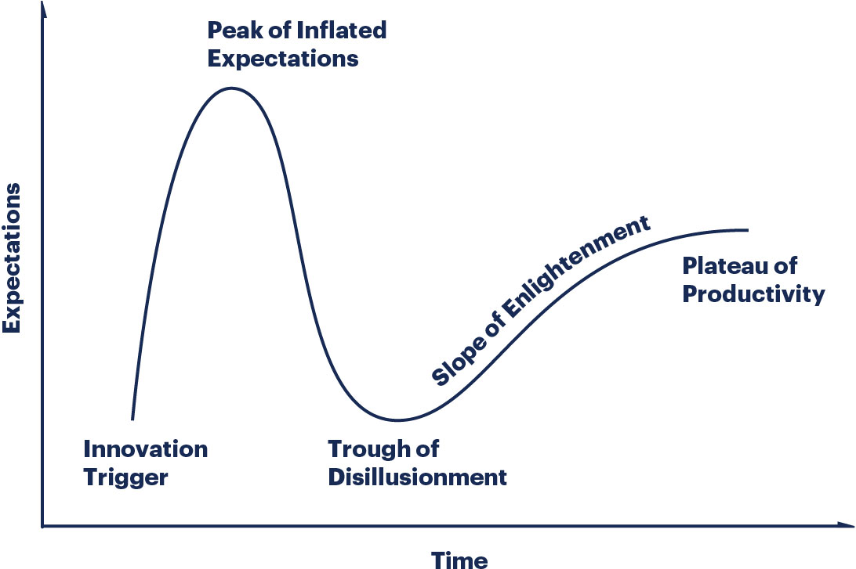
What do we mean by “new and emerging”?
Hypecycles
Commercial projections
Academic literature
(e.g. Price, 2020)
(e.g. Dunn, 2017)
(e.g. Wickramasinghe and Bodendorf, 2020)
Price, 2020. The Digital Health hypecycle 2020
Dunn, 2017. Digital health: Current state and future growth 2017-2025
Notes:
An important question to ask is Where have I sourced my examples? Here are some of the main sources I have used from which I have continued a snowball review of the grey and academic literature.
Hypecycles (Price, 2018, 2019, 2020)
Some of you might be familiar with the hypecycles published by Gartner. Gartner is a global IT research and advisory firm. Their hypecycles are only available for a fee but their hypecycle graphical presentation has been adopted by other authors in the IT community. As far as I am concerned, anything before the Plateau of Productivity is a new and emerging innovation, but that doesn’t mean the consequences of the innovation have taken effect fully, yet.
Commercial projections (Dunn, 2017; Hayward, 2019)
I’ve also been informed by some commercial projections published online...
Academic literature (Wickramasinghe and Bodendorf, 2020)
…and, of course, the academic literature.

Slide 9
What are the suggested, new-and-emerging health information technologies?
Swallowables
Mail-order prescription
Neural implants and interfaces
Loneliness and social isolation technology
Blockchain
Biohacking
Digital Twin
Omics
Conversational A.I.
Commercial telemedicine
Wearables
Immersive technology
Internet of Things
A.I.-assisted decision support
Drones
Mobile health app’s & patient portals
Notes:
Here are some new and emerging healthcare technologies that I have collated as a starting point for us all. There is a file in the GitHub repository called “v1.1 Table 1.pdf” that lists all of these technologies, provides an informal definition, some examples and direction to key literature.
These technologies cover the spectrum from hardware to software, and a range of potential users. This list is by no means exhaustive and I hope we can co-develop an appropriate list. In the breakout sessions after my presentation, you are free to offer any additions that you think I have missed.
At this point I would like to remind us all about what I said about thinking in terms of a healthcare information system. So, as you look over these technologies, we want to be thinking about hardware, software, people, data, processes, and their relationships to one another. Think also about how information is created, transferred and stored.
So, if what I have just shown are the new and emerging technologies, then What are the challenges?

Slide 10
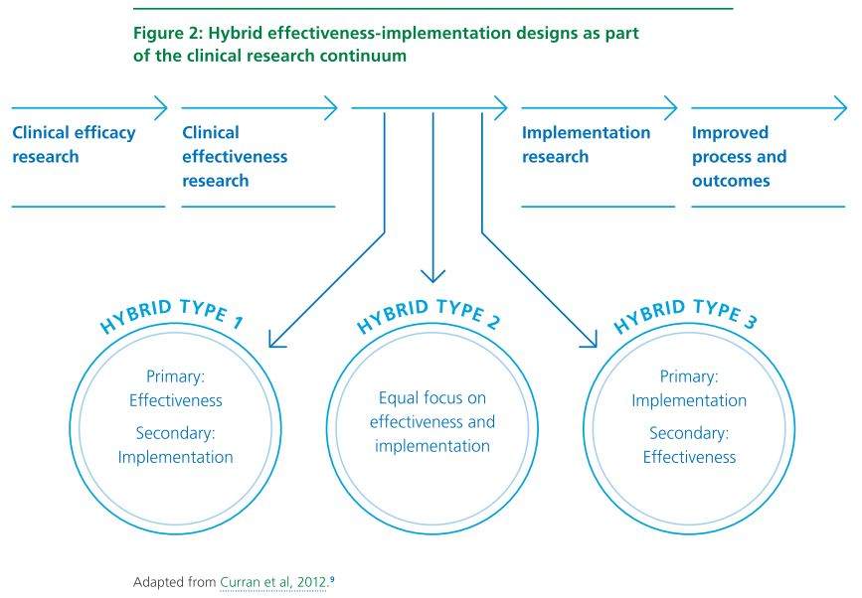
What are the (novel) challenges?
No testing before implementation
Digital inequality
(Roshanov, et al., 2011;
van de Velde, et al., 2018)
Transient relevance of models
Aging population
(King’s Improvement Science, 2018)
Roshanov, et al., 2011. Implementation Science. 6(88)
van de Velde, et al., 2018. Implementation Science. 13(86)
Notes:
So, if what I have just shown are the new and emerging technologies, then What are the challenges?
For this, I want to be even less prescriptive. Indeed, the purpose of this collaboration is derive and discuss a list of patient-safety challenges.
Nevertheless, it would be wise to recognise that there are old challenges that we are carrying forward. As a starting point, I’ve suggested these four:
No testing before implementation
Many have called for improved evaluation of technologies before they are set free into the healthcare system ecology (Roshanov et al., 2011; van de Velde et al., 2018). Improvement Scientists have advocated this for a long time, provide models such as the hybrid effectiveness implementation design (King’s Improvement Science, 2018). In opposition to this complete approach will always be the pragmatic view “It would be unrealistic to require repeated testing. Regardless, I’d also argue that calls for improved evaluation still won’t address patient safety, indeed it can’t, until we figure out a way to evaluate patient safety with fidelity.

Slide 11
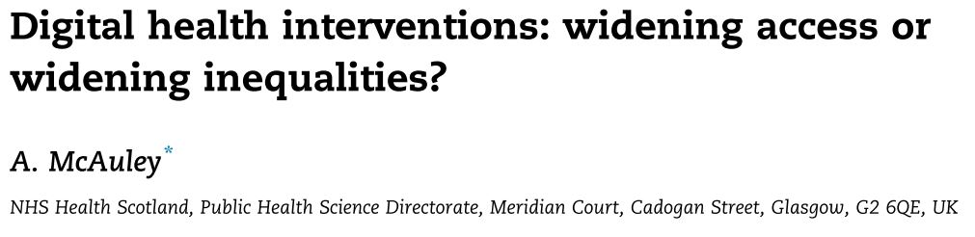
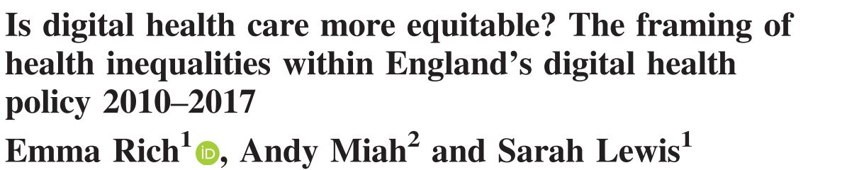

What are the (novel) challenges?
No testing before implementation
Digital inequality
Transient relevance of models
Aging population
McAuley, 2014. Public Health. 128(12) | Rich, et al., 2014. Public Health. 123(12)
Robinson, et al., 2015. Information Communication and Society. 18(5)
Notes:
Digital Inequality
This is a posterchild for our systemic approach. It highlights that digital health innovation is not benevolent just because it was intended to be. Instead, every innovation will be preferential to some groups and not to others. Digital health innovation carries with it all the socioeconomic and age-related biases associated with any digital innovation. We must ask ourselves: Are the new and emerging technologies just more of the same, or will they facilitate a new class of digital inequality?

Slide 12
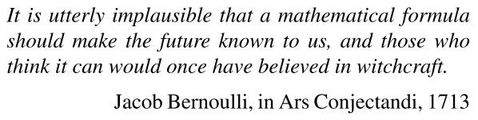
What are the (novel) challenges?
No testing before implementation
Digital inequality
Transient relevance of models
Aging population
Notes:
Transient relevance of models
This raises the question For how long will a model be useful? The challenge is perhaps best summarised by the economist’s joke that says “Forecasting is like steering a car by looking through the rear-view mirror” (Hand, 2009). We only have past data to go on. Arguably, the further into the past you go to retrieve that data, the less relevant the data is.
Ultimately, the future is neither obscured nor obfuscated – we could work with that – no, ultimately the future is unknowable until it has passed. I always like to remember Bernoulli’s statement, which will always be true.
And Bernoulli’s statement is a problem with any model that tries to predict risk or forecast anything.

Slide 13

What are the (novel) challenges?
No testing before implementation
Digital inequality
Transient relevance of models
Aging population
Notes:
A final suggested challenge is ‘Aging population’. I recommend Bricker and Ibbitson’s provocative book ‘Empty Planet’ that explains how our population is decelerating while our oldest members are living longer but not necessarily living stronger. At a macro-economic level, we are likely to see declining economic productivity and a reduced workforce, and as individuals age, we expect physical and cognitive decline. How can complicated and complex digital health technologies fit into such a world?

Slide 14
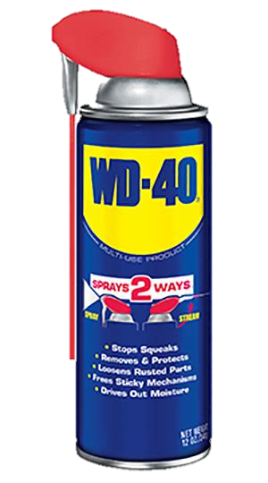

What are the (novel) challenges?
What next?
The “adjacent possible”:
the possible future states of a system, given the True current state.
(Kaufman, 2002)
intended future state
incompletely-informed current state
Kaufman, 2002. Investigations. Oxford University Press
Notes:
With such challenges already facing us, what novel challenges will we also have to face from new and emerging digital health technologies? This is the question that we will be addressing in the breakout session in a few minutes time.
We will be trying to imagine new challenges, which is difficult when we only have experience of the old challenges. To help us, we will look to complexity science and biophilosophy and consider Stuart Kauffman’s concept of the “adjacent possible” (Kauffman, 2002). The adjacent possible refers to the possible future states of a system, given the True current state. This relates strongly to the idea of exaptation that was presented at the beginning of the presentation.
Importantly, Adjacent Possibles are distinct from the intended future states of a system. An example I like to give is that of WD-40, which was developed by a small American company for the express intention to protect rocket missiles from rust and corrosion. The inventors never conceived the adjacent possible application as a ubiquitous lubricant.
Furthermore, adjacent possibles are also distinct from possible future states supposed by an incompletely-informed current state, as opposed to the True current state. The message that I’m trying to communicate here is that we are not going to do a good job of foreseeing novel challenges if we don’t have a faithful conception of the True current state of healthcare information technology systems.

Slide 15
Solutions
(Habli, et al., 2020)
Safety cases and safety assurance
Standards
TRIPOD (Transparent Reporting of a multivariable prediction model for Individual Prognosis Or Diagnosis) (Collins et al., 2015; Moons et al., 2015)
CONSORT (CONsolidated Standards of Reporting Trials) (Moher et al., 2010; Schulz et al., 2010)
AI-TREE (Artificial Intelligence-Transparent, Replicable, Ethical, Effective) (Vollmer et al., 2020)
Other standards (Cowley et al., 2019; King’s Improvement Science, 2018)
But…Reporting ≠ Applying method
(Altman, et al., 2017)
Habli, Lawton and Porter, 2020. Bul World Health Organ. 98
Altman, et al., 2017. HPB. 19(7)

Slide 16

Solutions
Dynamic and causal modelling
Machine learning for data quality
(Sperrin, et al., 2018; 2019)
(Sako, et al., 2020)
A
Resilience
Anti-fragility
System Performance
D
B
C
Sperrin, et al., 2018. Statistics in Medicine. 37(28)
Sperrin, et al., 2019. JAIMA. 26(12) | Sako, et al., 2020.

Slide 17
Patient-safety challenges posed by new and emerging health information technologies
Ciarán McInerney, PhD.
@CMc_PhD

Slide 18
Breakout sessions

